Slide 1


Lung Cancer Survival Prediction Using CT Scans, Clinical Data & Pathology Reports
Minor Project - Review 1 | Dept. of CSE (AI & ML)
Student 1: [M.Anosh Reddy] ([ENG23AM0157])
Student 2: [P.Devamshu] ([ENG23AM0171])
Student 3: [M.Ram Charan] ([ENG23AM0155])
Student 4: [N.Sai Vamshi] ([ENG23AM0165])
Guided By: [ MR. SRIRAMKUMAR R ]
[Assistant Professor], Dept. of CSE (AI & ML)
Dayananda Sagar University, Bengaluru

Slide 2
Objectives
To develop a multimodal AI model that predicts lung cancer patient survival by combining CT scan images, clinical tabular data, and pathology reports.
To improve prediction accuracy and early risk stratification compared to single- data-source models
To build a clinically interpretable risk scoring system that categorizes patients into low-, medium-, and high-survival risk groups for better treatment planning.

Slide 3
Introduction
Introduction:
Lung cancer is one of the leading causes of cancer-related deaths worldwide, mainly due to late diagnosis and inaccurate survival estimation. Early and precise survival prediction is crucial for personalized treatment planning.
Problem Statement:
To develop a predictive model that accurately estimates the survival probability of lung cancer patients using medical data (CT scans, clinical features, and pathology reports).
Gaps in Current Solutions:
1)Limited use of pathology text reports due to NLP complexity.
2) No personalization based on patient-specific risk factors.
3)Most models use single-modality data (only imaging or only clinical data)

Slide 4
Literature Review
S.No. | Details of Paper (Harvard Style) | Objectives, Dataset, Methodology / Models Used | Results / Advantages / Limitations
1 | Ardila et al. (2019). Lung cancer detection from CT scans using deep learning. Nature Medicine. | Goal: Detect if a CT scan shows cancer. Data: 45,856 CT scans (NLST + UK Biobank). Method: A 3D deep learning model trained on CT images to predict cancer risk. | Outperformed radiologists (AUC 0.944 vs 0.856). Fewer false results. Limitation: Only detects cancer — does not predict survival or use clinical data.
2 | Katzman et al. (2018). DeepSurv: A deep learning model for predicting patient survival. BMC Medical Research Methodology. | Goal: Predict survival using patient records. Data: Multiple clinical datasets including NLST. Method: A neural network that estimates survival risk from patient data. | 3-7% better accuracy than traditional models. Limitation: Uses clinical data only — no CT images or pathology reports.

Slide 5
Literature Review
S.No. | Details of Paper (Harvard Style) | Objectives, Dataset, Methodology / Models Used | Results / Advantages / Limitations
3 | Yao et al. (2020). Cancer survival prediction from pathology slide images using deep learning. Medical Image Analysis. | Goal: Predict lung cancer survival from microscopic tissue images. Data: TCGA lung cancer datasets. Method: AI model that scans large pathology images in parts and focuses on important regions. | Good accuracy (C-index ~0.75) using only pathology images. Limitation: Does not use CT scans or patient clinical records.
4 | Chen et al. (2021). Combining pathology images and gene data for cancer survival prediction. ICCV 2021. | Goal: Use both tissue images and genomic data to predict survival. Data: TCGA lung cancer datasets. Method: A transformer model that links image regions with gene expression data. | Best reported accuracy on lung cancer datasets. Limitation: Uses genomics data, not CT scans or clinical records — not practical in most hospitals.

Slide 6
Literature Review
S.No. | Details of Paper (Harvard Style) | Objectives, Dataset, Methodology / Models Used | Results / Advantages / Limitations
5 | Huang et al. (2020). SALMON: Predicting lung cancer survival using multiple types of biological data. npj Precision Oncology. | Goal: Improve survival prediction by combining gene-level data types. Data: TCGA lung cancer patients. Method: Separate AI encoders for each data type, then combined for final prediction. | Better accuracy than single-data models. Limitation: Requires genomic tests not available in all hospitals; no CT scans or clinical records used.
6 | Aerts et al. (2014). Predicting lung cancer outcomes using CT scan features (radiomics). Nature Communications. | Goal: Use CT scan measurements to predict lung cancer outcomes. Data: 422 lung cancer patients. Method: Extracted 440 features (shape, texture, intensity) from CT tumor region. | Moderate accuracy (C-index 0.65). Showed CT texture features are useful for prognosis. Limitation: Uses only hand-picked features — no deep learning or other data types.

Slide 7
Literature Review
S.No. | Details of Paper (Harvard Style) | Objectives, Dataset, Methodology / Models Used | Results / Advantages / Limitations
7 | Liu et al. (2020). Lung cancer survival prediction using multimodal data and graph neural networks. IEEE BIBM. | Goal: Combine CT images, gene data, and clinical stage to predict survival. Data: TCGA-LUAD (412 patients). Method: A graph network connecting similar patients to improve prediction. | 7-9% better than single-data models (C-index 0.718). Limitation: Needs genomic data not available in routine clinical use; no pathology text or explainability.
8 | Mobadersany et al. (2018). Predicting cancer outcomes from tissue images and genetic data. PNAS. | Goal: Combine tissue slide images with gene risk score to predict cancer outcomes. Data: TCGA lung and brain datasets. Method: CNN extracts features from tissue images, combined with genomic risk. | 11% better than clinical-only model. Visual maps show high-risk tumor areas. Limitation: No CT scans or clinical records; uses only binary gene risk, not detailed genomic data.

Slide 8
Literature Review
S.No. | Details of Paper (Harvard Style) | Objectives, Dataset, Methodology / Models Used | Results / Advantages / Limitations
9 | Steyaert et al. (2023). Comparing methods to combine multiple data types for cancer prediction using deep learning. Nature Machine Intelligence. | Goal: Find the best way to combine imaging and genomic data for cancer prediction. Data: TCGA (14 cancer types including lung). Method: Tested 6 different fusion strategies and compared their performance. | Cross-modal attention fusion worked best (5-12% improvement). Limitation: Only used tissue images and genomics — CT scans not included.
10 | Shen et al. (2019). Using AI to predict survival in lung cancer patients with brain tumors. JAMA Network Open. | Goal: Predict survival in lung cancer patients with brain spread. Data: 1,185 patients. Method: Random forest and neural network on clinical variables; used SHAP to explain which factors mattered most. | High accuracy (AUC 0.81), better than traditional scoring methods. Limitation: Only uses clinical data — no CT scans; limited to patients with brain spread, not all lung cancer cases.

Slide 9
Dataset
1] Clinical Dataset
Age
Gender
Smoking history
Tumor stage
Treatment details
Survival tim
3] Pathology Report Dataset
Histopathology diagnosis
Tumor type
Grade
Molecular markers
2] CT Image Dataset
Chest CT scans
Tumor region (Region of Interest – ROI)
Shape features
Texture features
Volume features

Slide 10
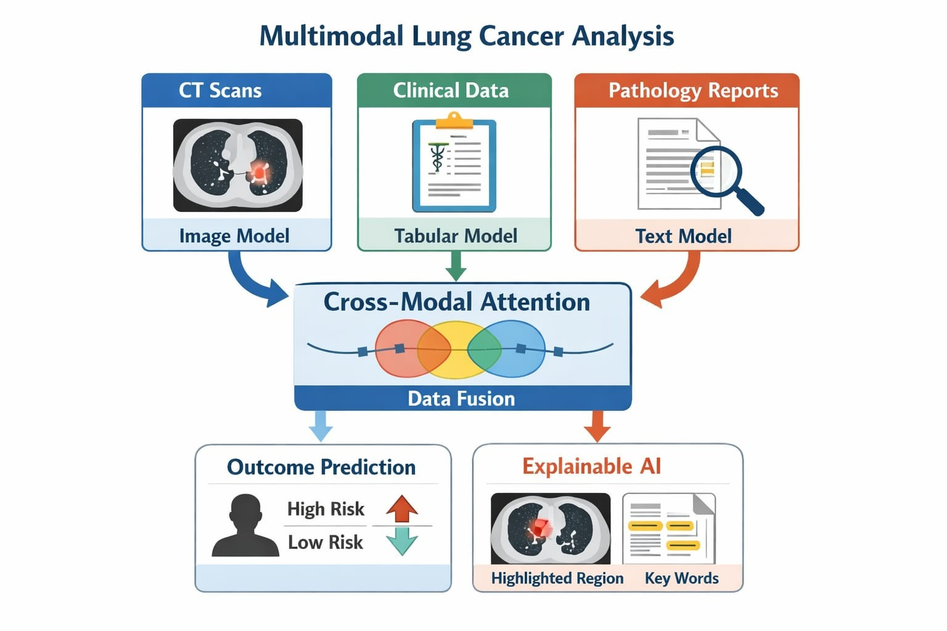
Methodology

Slide 11
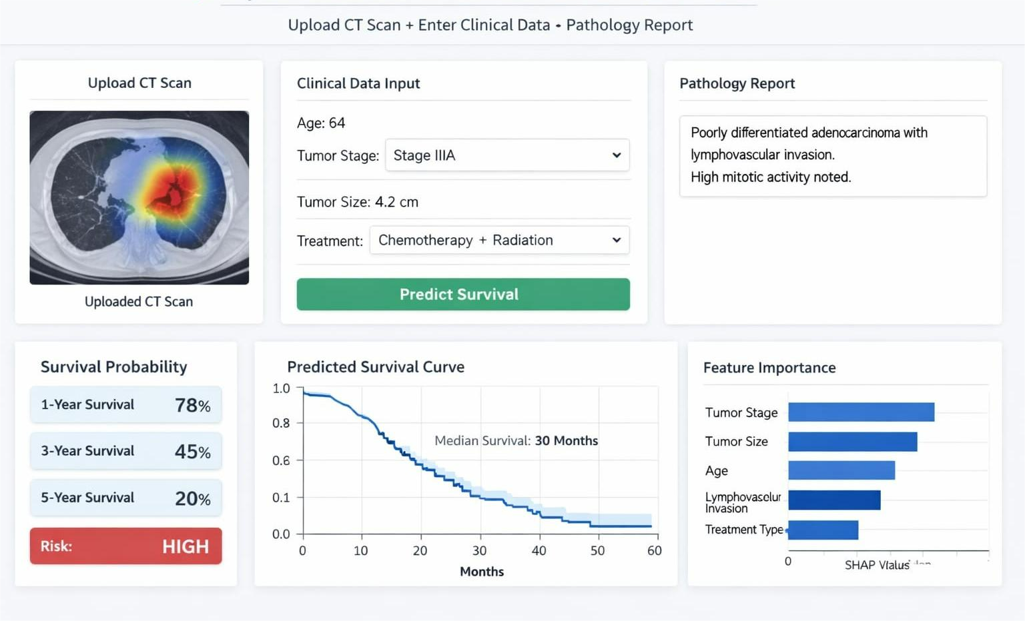
Results

Slide 12
References
[1] Ardila, D. et al. (2019). End-to-end lung cancer detection on CT scans using deep learning. Nature Medicine, 25(6), pp.954-961.
[2] Katzman, J.L. et al. (2018). DeepSurv: Personalized treatment recommender system using a Cox proportional hazards deep neural network. BMC Medical Research Methodology, 18(1), p.24.
[3] Yao, J. et al. (2020). Whole slide images based cancer survival prediction using attention guided deep multiple instance learning. Medical Image Analysis, 65, p.101789.
[4] Chen, R.J. et al. (2021). Multimodal co-attention transformer for survival prediction in gigapixel whole slide images. ICCV 2021, pp.3995-4005.
[5] Huang, Z. et al. (2020). SALMON: Survival Analysis Learning with Multi-Omics Neural Networks on Lung Cancer. npj Precision Oncology, 4(1), p.11.
[6] Aerts, H.J.W.L. et al. (2014). Decoding tumour phenotype by noninvasive imaging using a quantitative radiomics approach. Nature Communications, 5, p.4006.
[7] Liu, Y. et al. (2020). Predict lung cancer survival based on multimodal data using graph neural networks. IEEE BIBM 2020, pp.557-560.
[8] Mobadersany, P. et al. (2018). Predicting cancer outcomes from histology and genomics using convolutional networks. PNAS, 115(13), pp.E2970-E2979.
[9] Steyaert, S. et al. (2023). Multimodal data fusion for cancer biomarker discovery with deep learning. Nature Machine Intelligence, 5, pp.351-362.
[10] Shen, W. et al. (2019). Mining prognosis index of brain metastases from lung cancer using artificial intelligence. JAMA Network Open, 2(12), p.e1917091.

Slide 13


